Slide 1
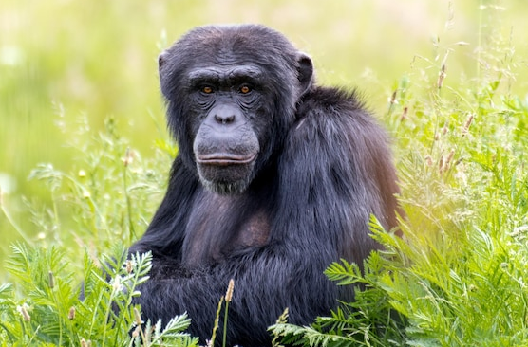
Progress Report
Shu-Cheng
3/14/2025

Slide 2
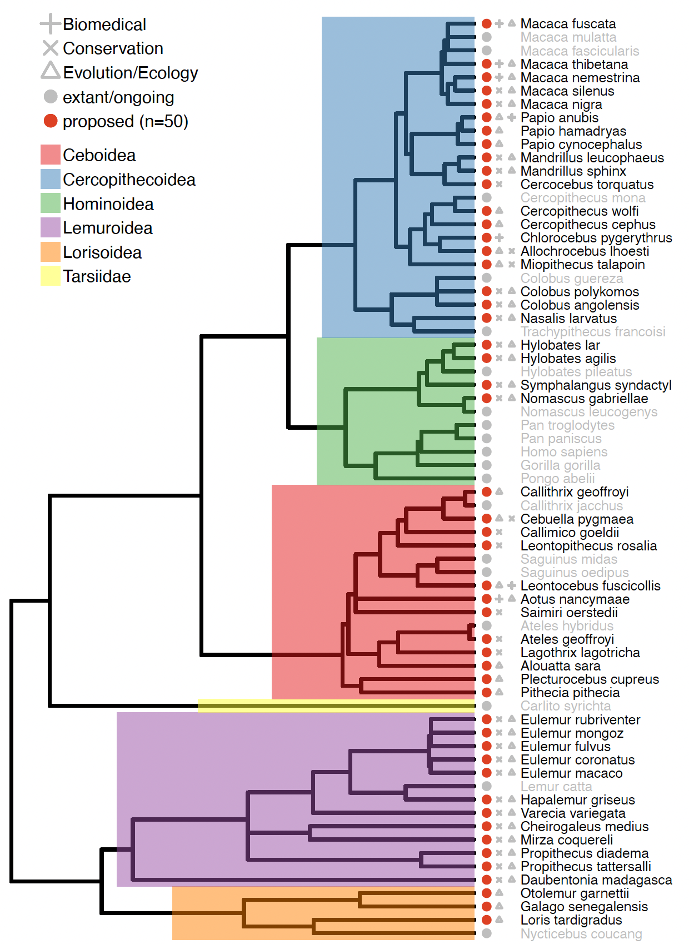
Primate pangenome project
Total 50 primates’ genomes
Phase 1 (2024): 10+3 primates
Phase 2 (2025): 7 primates
Received 20 primates so far…
-ONT sequencing report
(Peter Sudmant Lab)

Slide 3
Two approaches working in the Lab
Phenol-chloroform (PC)
(Logsdon & Chuang 2024)
FindingNemo (FN)
(Cahyani et al. 2024)
DNA extraction
18e6 cells, isopropanol precipitation
7e6 cells, Monarch HMW DNA extraction kit
Library preparation
SQK-ULK114 (ONT)
SQK-ULK114 (ONT)
Library clean-up
Spermine-base PPT precipitation, w.o. beads
CoHex precipitation, with beads
PromethION platform sequencing
CoHex: Hexamminecobalt(III) chloride

Slide 4
11 Primates PC results
Sample ID | Common name | # of flow cells run | Total ONT data generated | Total ONT data generated | Read N50 (kbp) | UL ONT data generated | UL ONT data generated | UL ONT/ ONT (%)
 |  |  | (Gbp) | (fold cov) |  | (Gbp) | (fold cov)
PR00036 | Olive Baboon | 1 (PC15) | 29.11 | 9.39 | 119.6 | 16.65 | 5.37 | 57.2
PR00036 | Olive Baboon | 1 (PC14) | 46.88 | 15.12 | 97.8 | 23.04 | 7.43 | 49.15
PR00232 | Drill | 1 (PC) | 37.86 | 12.21 | 87.2 | 16.83 | 5.43 | 44.5
PR00099 | Angolan Colobus | 1 (PC) | 81.86 | 26.41 | 98.5 | 40.42 | 13.04 | 49.3
PR00030 | Southern Pig-tailed Macaque (SPM) | 1 (PC1) | 55.14 | 17.78 | 110.3 | 29.97 | 9.66 | 54.3
PR00030 | SPM | 1 (PC2) | 31.38 | 10.12 | 117.9 | 17.94 | 5.78 | 57.2
PR00128 | Black Lemur | 1 (PC1) | 66.98 | 21.61 | 98.6 | 33.13 | 10.68 | 49.5
PR00128 | Black Lemur | 1 (PC2) | 24.02 | 7.75 | 157.5 | 16.24 | 5.24 | 67.6
PR00129 | Red-bellied Lemur | 1 (PC1) | 46.96 | 15.14 | 142.1 | 29.73 | 9.59 | 63
PR00129 | Red-bellied Lemur | 1 (PC2) | 43.85 | 14.14 | 109.3 | 23.25 | 7.5 | 53.02
PR00246 | Brown Lemur | 1 (PC1) | 46.52 | 15 | 92.4 | 21.92 | 7.07 | 47.11
PR00246 | Brown Lemur | 1 (PC2) | 41.99 | 13.54 | 78.1 | 17.23 | 5.74 | 41
PR00525 | Common Woolly Monkey (CWM) | 1 (PC1) | 52.9 | 17.06 | 120.3 | 30.2 | 9.74 | 57.1
PR00525 | CWM | 1 (PC2) | 64.73 | 20.88 | 101.7 | 32.77 | 10.57 | 50.6
PR00786 | Golden Lion Tamarin | 1 (PC1) | 52.9 | 17.06 | 120.3 | 30.2 | 9.74 | 57.1
PR00786 | Golden Lion Tamarin | 1 (PC2) | 64.73 | 20.88 | 101.7 | 32.77 | 10.57 | 50.6
PR00239 | White-faced Saki | 1 (PC1) | 73.35 | 23.66 | 108.8 | 39.31 | 12.68 | 53.59
PR00239 | White-faced Saki | 1 (PC2) | 79.8 | 25.74 | 122.1 | 46.73 | 15.07 | 58.11
PR00674 | Proboscis Monkey | 1 (PC1) | 39.17 | 12.34 | 134.3 | 24.2 | 7.81 | 61.78
PR00674 | Proboscis Monkey | 1 (PC2) | 51.52 | 16.62 | 138.9 | 32.81 | 10.58 | 63.68
 | sum | 20 | 1031.65 | 332.45 | 2257.4 | 555.34 | 179.29 | 1085.44
 | mean |  | 51.5825 | 16.6225 | 112.87 | 27.767 | 8.9645 | 54.272

Slide 5
11 Primates FN results
Sample ID | Common name | # of flow cells run | Total ONT data generated | Total ONT data generated | Read N50 (kbp) | UL ONT data generated | UL ONT data generated | UL ONT/ ONT (%)
 |  |  | (Gbp) | (fold cov) |  | (Gbp) | (fold cov)
PR00036 | Olive Baboon | 2 (FN) | 126.45 | 40.79 | 69.3 | 37.8 | 12.19 | 29.9
PR00232 | Drill | 1(FN1) | 75.02 | 24.2 | 79.5 | 28.96 | 9.34 | 38.6
PR00232 | Drill | 1 (FN2) | 41.55 | 13.4 | 82 | 16.61 | 5.36 | 39.98
PR00099 | Angolan Colobus | 1 (FN) | 84.59 | 27.28 | 96.8 | 41 | 13.22 | 48.4
PR00030 | Southern Pig-tailed Macaque | 1 (FN1) | 68.87 | 22.21 | 79.3 | 26.94 | 8.69 | 39.2
PR00128 | Black Lemur | 1 (FN) | 51.87 | 16.73 | 70.3 | 17.7 | 5.71 | 34.1
PR00129 | Red-bellied Lemur | 1 (FN1) | 71.88 | 23.18 | 74.9 | 27.78 | 8.96 | 38.65
PR00246 | Brown Lemur | 1 (FN1) | 64.52 | 20.81 | 85.5 | 27.66 | 8.92 | 42.87
PR00786 | Golden Lion Tamarin | 2 (FN) | 80.32 | 25.91 | 97.9 | 39.46 | 12.73 | 49.13
PR00485 | White-faced Saki | 1 (FN1) | 55.15 | 17.79 | 68.5 | 17.97 | 5.8 | 32.58
PR00485 | White-faced Saki | 1 (FN2) | 101.17 | 32.64 | 81.4 | 40.69 | 13.13 | 40.22
PR00485 | White-faced Saki | 1 (FN3) | 101.04 | 32.71 | 77.1 | 37.74 | 12.17 | 37.35
PR00239 | White-faced Saki | 1 (FN1) | 48.78 | 15.74 | 78.5 | 19.84 | 6.4 | 40.67
PR00030 | Southern Pig-tailed Macaque | 1 (FN2) | 28.36 | 9.15 | 113.2 | 15.85 | 5.11 | 55.89
PR00246 | Brown Lemur | 1 (FN2) | 47.13 | 15.2 | 106.7 | 24.87 | 8.02 | 52.77
PR00525 | Common Woolly Monkey (CWM) | 1 (FN1) | 81.53 | 26.3 | 96.6 | 39.47 | 12.73 | 48.41
 | sum | 16 | 1128.23 | 364.04 | 1357.5 | 460.34 | 148.48 | 668.72
 | mean |  | 70.514375 | 22.7525 | 84.84375 | 28.77125 | 9.28 | 41.795

Slide 7
Sample ID | # of flow cells run | Total ONT data generated (Gbp; fold cov) | Read N50 (kbp) | UL ONT data generated (Gbp; fold cov)
PR00036 | 4 | 202.44; 65.30x | 78.3 | 77.49; 25.00x
PR00099 | 2 | 166.45; 53.69x | 97.5 | 81.42; 26.26x
PR00030 | 4 | 183.67; 59.24x | 98.7 | 90.7; 29.26x
PR00129 | 3 | 162.69; 52.48x | 99.0 | 80.75; 26.05x
PR00246 | 4 | 200.16; 64.57x | 90.2 | 91.69; 29.58x
PR00525 | 3 | 199.17; 64.25x | 103.5 | 102.44; 33.05x
PR00239 | 3 | 201.93; 65.14x | 106.1 | 105.88; 34.15x
PR00485 | 3 | 257.36; 83.02x | 76.8 | 96.4; 31.10x
PR00128 | 4 | 152.15; 49.08x | 93.7 | 72.13; 23.26x
PR00786 | 5 | 198.89; 64.15x | 97.1 | 97.17; 31.34x
PR00674 | 3 | 164.81; 53.16x | 112 | 90.15; 29.08x
PR00557 | 5 | 219.85; 70.92x | 88.9 | 98.74; 31.85x
PR00232 | 4 | 202.01; 65.16x | 87.6 | 88.07; 28.41x
 | 47
→ 47/13= 3.6 FC/Sample

Slide 8
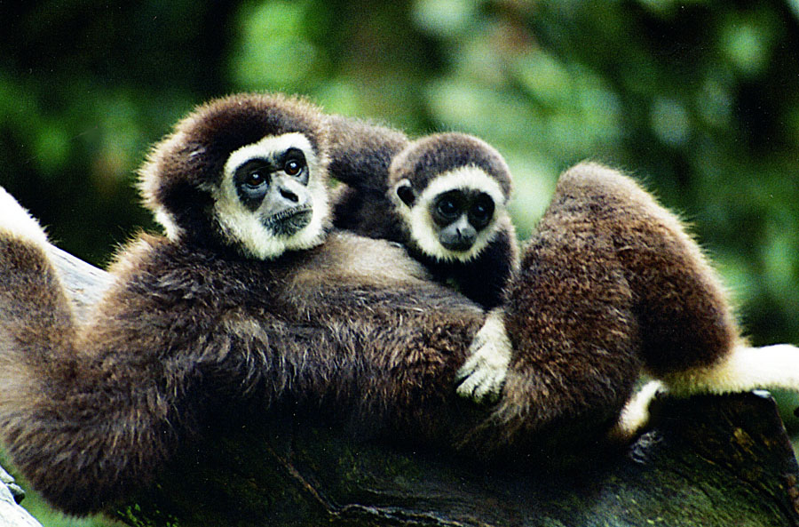
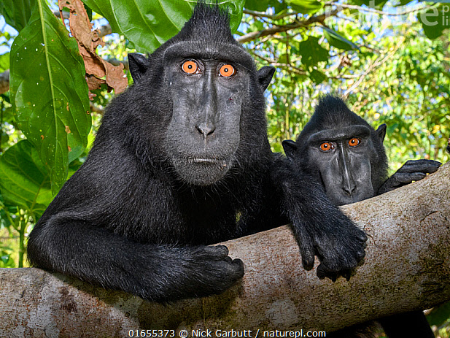
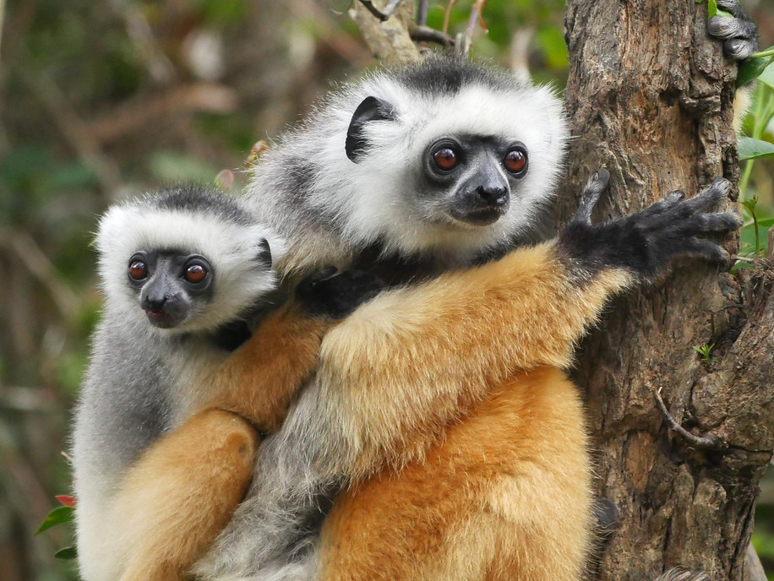
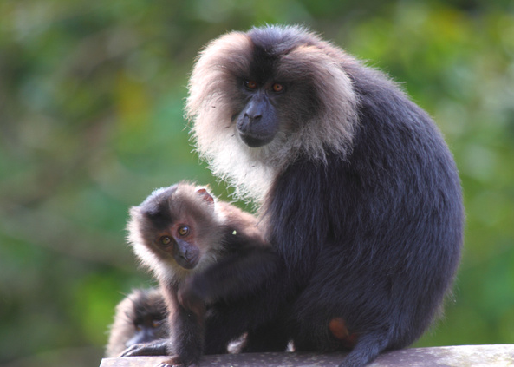
Sequenced sample # 14-17 (38 million cells/sample)
HLA
MNI
PDI
MSI
Cell line # | Species | Common name | Taxon | Abbreviation | DNA extraction date | Sequencing date (flow cell)
PPG00715 | Hylobates lar | Lar Gibbon | Lesser Ape | HLA | 12/5-6/24 | 12/10/24 (1PC, 2FN)
PPG00726 | Macaca nigra | Celebes Crested Macaque | Old World Monkey | MNI | 12/12-13/24 | 12/17/24 (1PC, 2FN)
PPG00740 | Propithecus diadema | Diademed Sifaka | Lemur | PDI | 11/26-27/24 | 12/3/24 (1PC, 2FN)
PPG00833 | Macaca silenus | Lion-tailed Macaque | Old World Monkey | MSI | 1/3/25 | 01/07/25 (2FN)
Notes:
Monkeys are divided into two main groups, Old World and New World, based on their geographic location and several other characteristics:
Location
Old World monkeys live in Africa, Asia, and Europe, while New World monkeys live in Central and South America.
Nose
Old World monkeys have narrow noses with nostrils that face downward, while New World monkeys have broad noses with nostrils that face outward. The term "platyrrhine" means "flat-nosed" in Latin, and refers to the New World monkeys.
Tails
Some New World monkeys, like spider monkeys, have prehensile tails, but Old World monkeys do not.
Rump pads
Some Old World monkeys have hard, bare sitting pads on their buttocks, but New World monkeys do not.
Cheek pouches
Some Old World monkeys, like macaques, have cheek pouches for storing food.
Intelligence
Old World monkeys are generally considered more intelligent than New World monkeys.
Thumbs
Old World monkeys have more opposable thumbs than New World monkeys.
Habitat
Old World monkeys spend most of their time on the ground, while New World monkeys spend most of their time in trees.

Slide 9
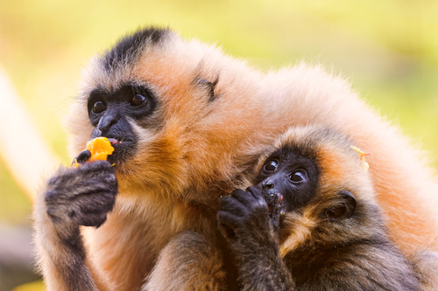
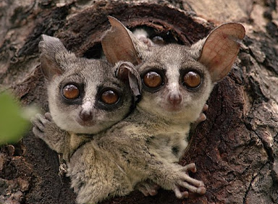
Sequenced sample # 19-20 (38 million cells/sample)
HAG
MFU
GSE
Cell line # | Species | Common name | Taxon | Abbreviation | DNA extraction date | Sequencing date (flow cell)
PPG00773 | Hylobates agilis | Agile Gibbon | Lesser Ape | HAG | 1/9-10/25 | 1/14,15/25 (1PC, 2FN)
PPG00782 | Macaca fuscata | Japanese Macaque | Old World Monkey | MFU | 1/17/25, 2/14/25 | 1/21, 28/25, 2/18/25 (1PC, 3FN)
PPG01034 | Galago senegalensis | Northern Lesser Galago | Galagos/Lorises | GSE | 1/17/25, 2/14/25 | 1/21, 28/25, 2/18/25 (1PC, 3FN)
Notes:
Monkeys are divided into two main groups, Old World and New World, based on their geographic location and several other characteristics:
Location
Old World monkeys live in Africa, Asia, and Europe, while New World monkeys live in Central and South America.
Nose
Old World monkeys have narrow noses with nostrils that face downward, while New World monkeys have broad noses with nostrils that face outward. The term "platyrrhine" means "flat-nosed" in Latin, and refers to the New World monkeys.
Tails
Some New World monkeys, like spider monkeys, have prehensile tails, but Old World monkeys do not.
Rump pads
Some Old World monkeys have hard, bare sitting pads on their buttocks, but New World monkeys do not.
Cheek pouches
Some Old World monkeys, like macaques, have cheek pouches for storing food.
Intelligence
Old World monkeys are generally considered more intelligent than New World monkeys.
Thumbs
Old World monkeys have more opposable thumbs than New World monkeys.
Habitat
Old World monkeys spend most of their time on the ground, while New World monkeys spend most of their time in trees.

Slide 10
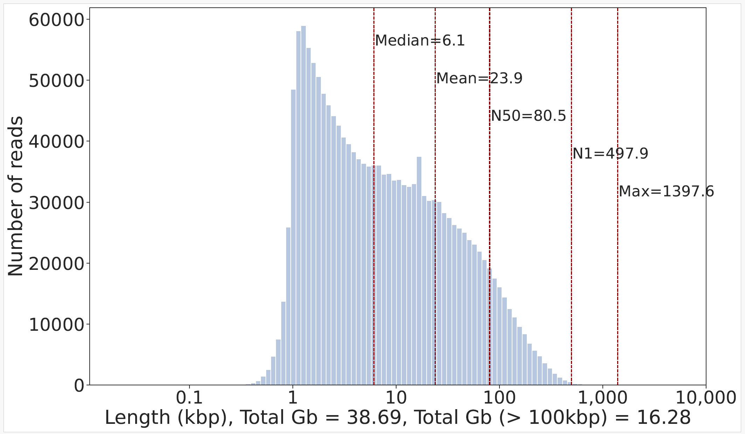
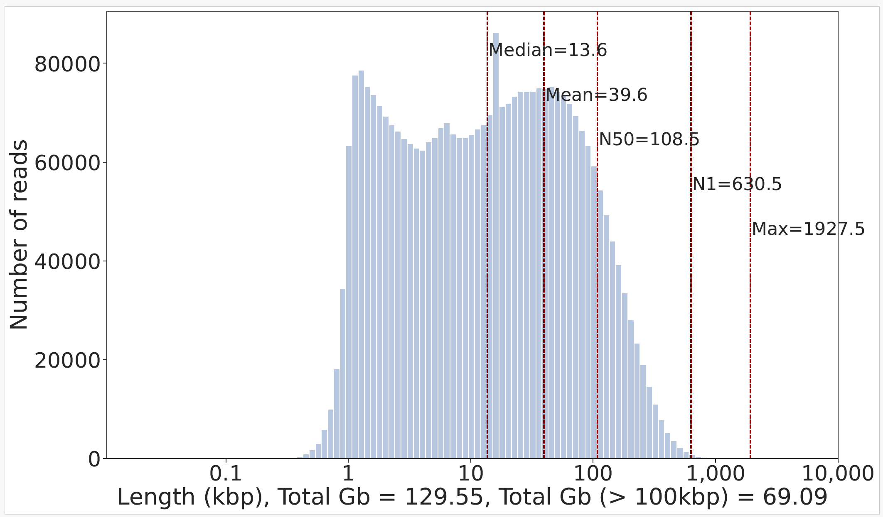
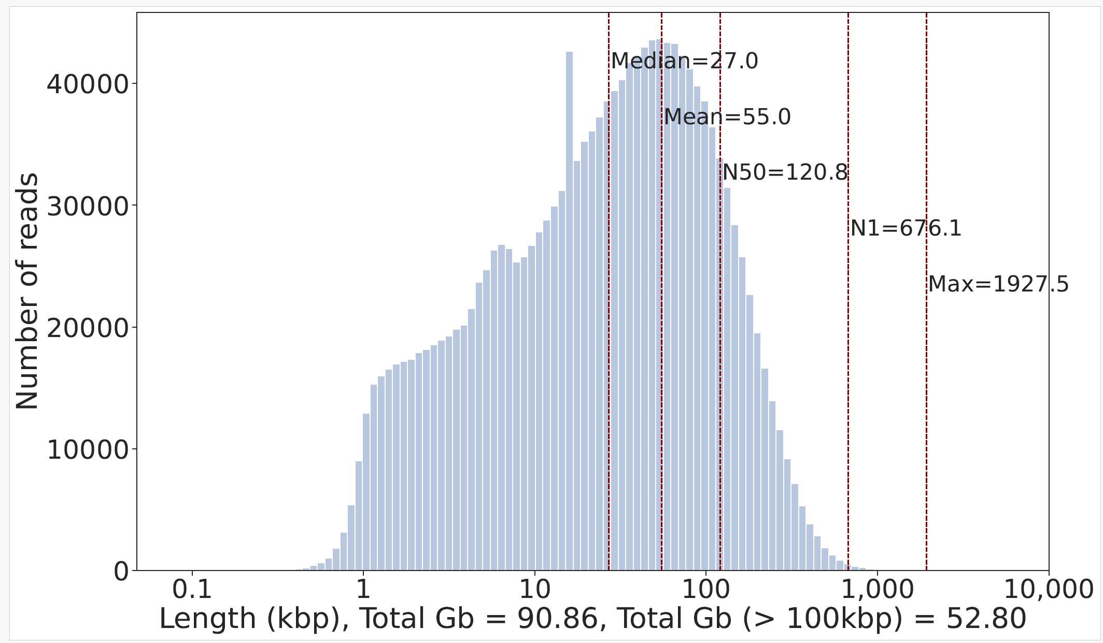
Sample ID | Common name | # of flow cells run | Total ONT data generated (Gbp; fold cov) | Read N50 (kbp) | UL ONT data generated (Gbp; fold cov) | UL ONT/ ONT (%)
PR00715 | Lar Gibbon | 1(PC1) | 38.69; 12.48x | 80.5 | 16.28; 5.25x | 42.08
 |  | 2(FN1,2) | 90.86; 29.31x | 120.8 | 52.8; 17.03x | 58.11
 |  | Total 3 | 129.55; 41.79x | 108.5 | 69.09; 22.28x | 53.33
OK
PR00715-All
PR00715-PC1
PR00715-2FN

Slide 11
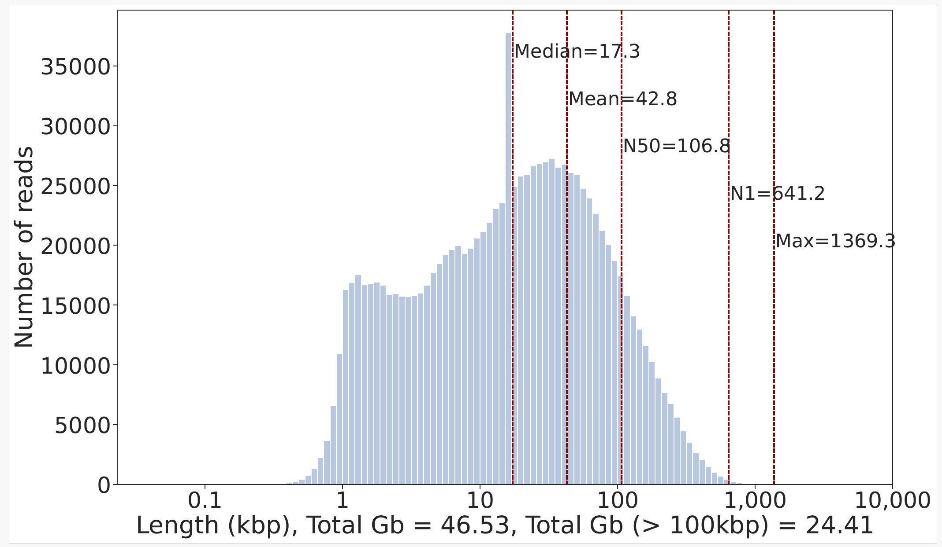
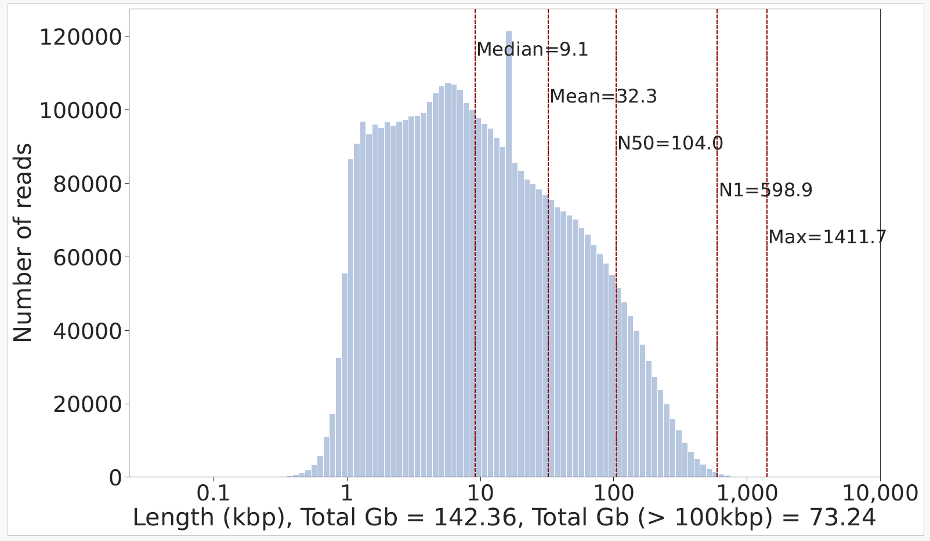
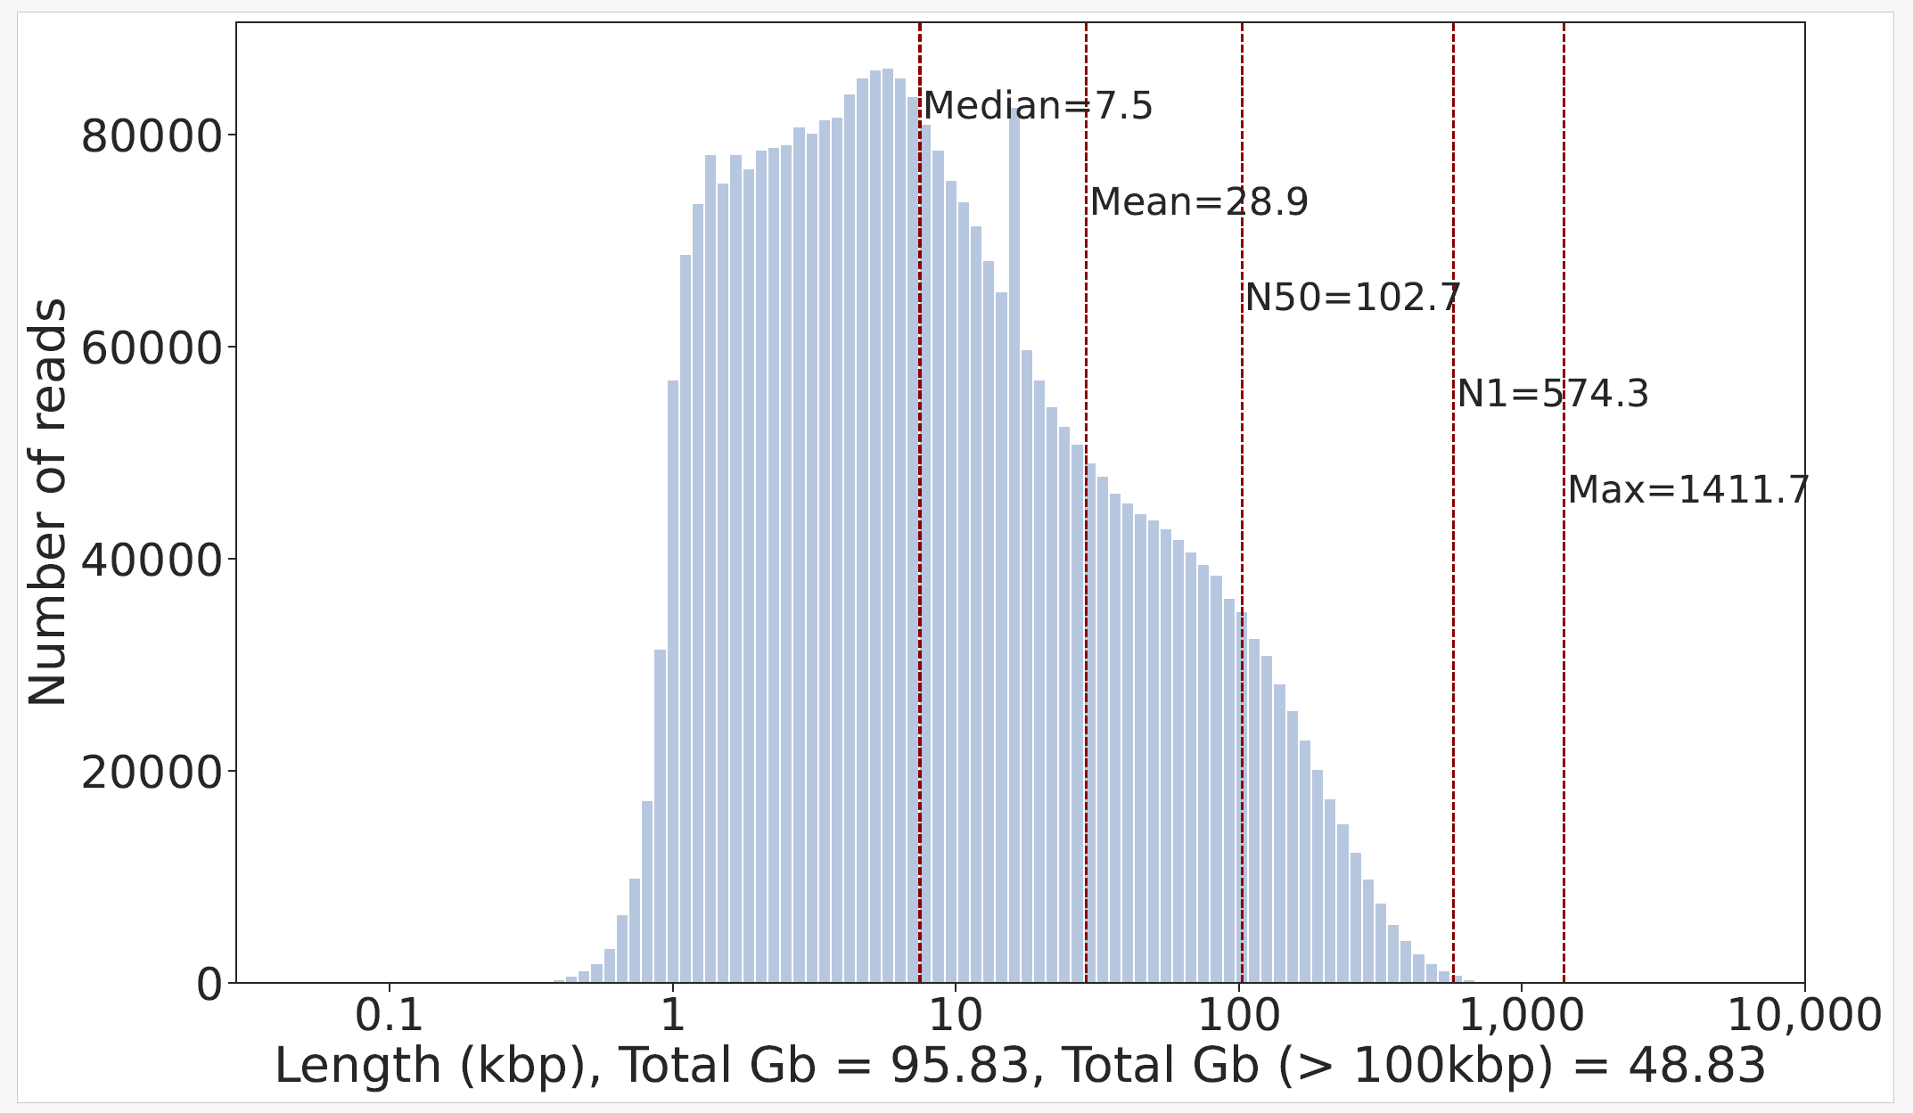
Sample ID | Common name | # of flow cells run | Total ONT data generated (Gbp; fold cov) | Read N50 (kbp) | UL ONT data generated (Gbp; fold cov) | UL ONT/ ONT (%)
PR00726 | Celebes Crested Macaque | 1(PC1) | 46.53; 15.01x | 106.8 | 24.41; 7.87x | 52.46
 |  | 3(FN1,2) | 95.83; 30.91x | 102.7 | 48.83; 15.75x | 50.95
 |  | Total 4 | 142.36; 45.92x | 104 | 73.24; 23.62x | 51.45
OK
PR00726-All
PR00726-PC1
PR00726-2FN

Slide 12
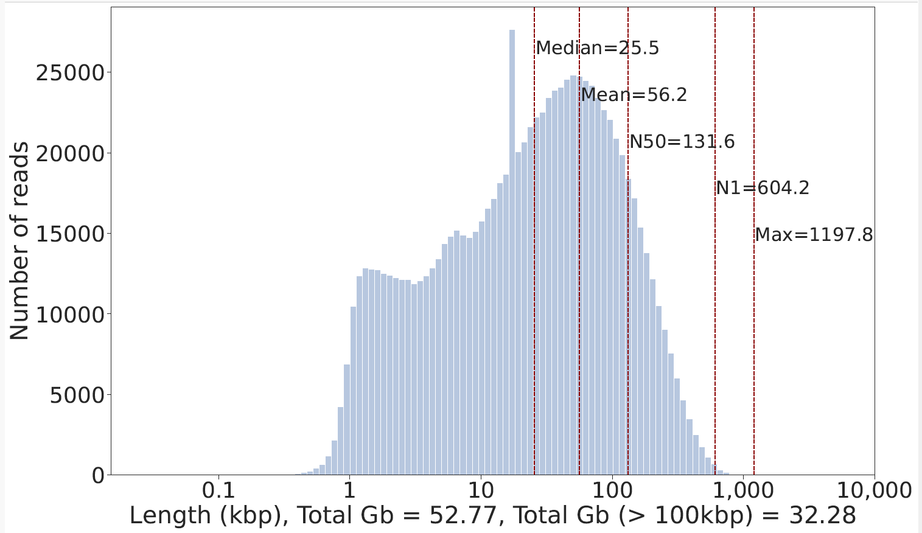
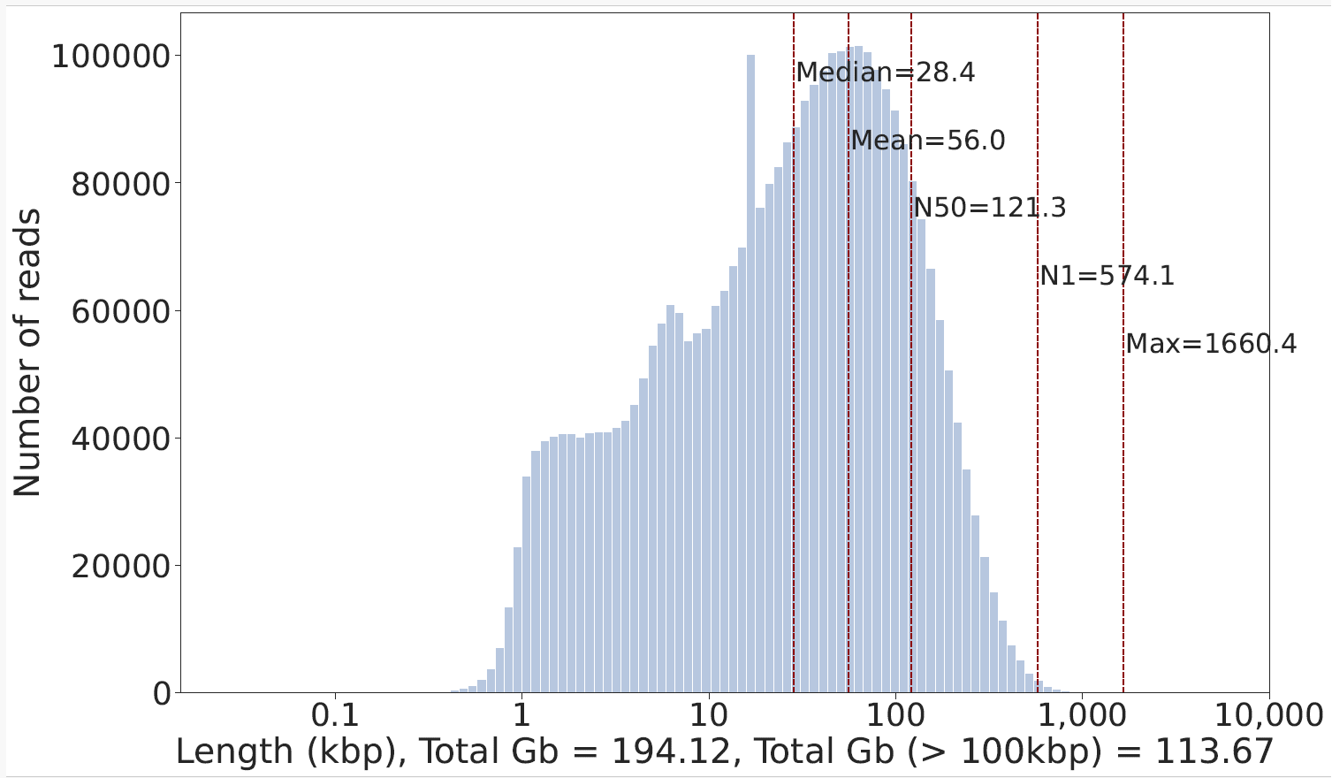
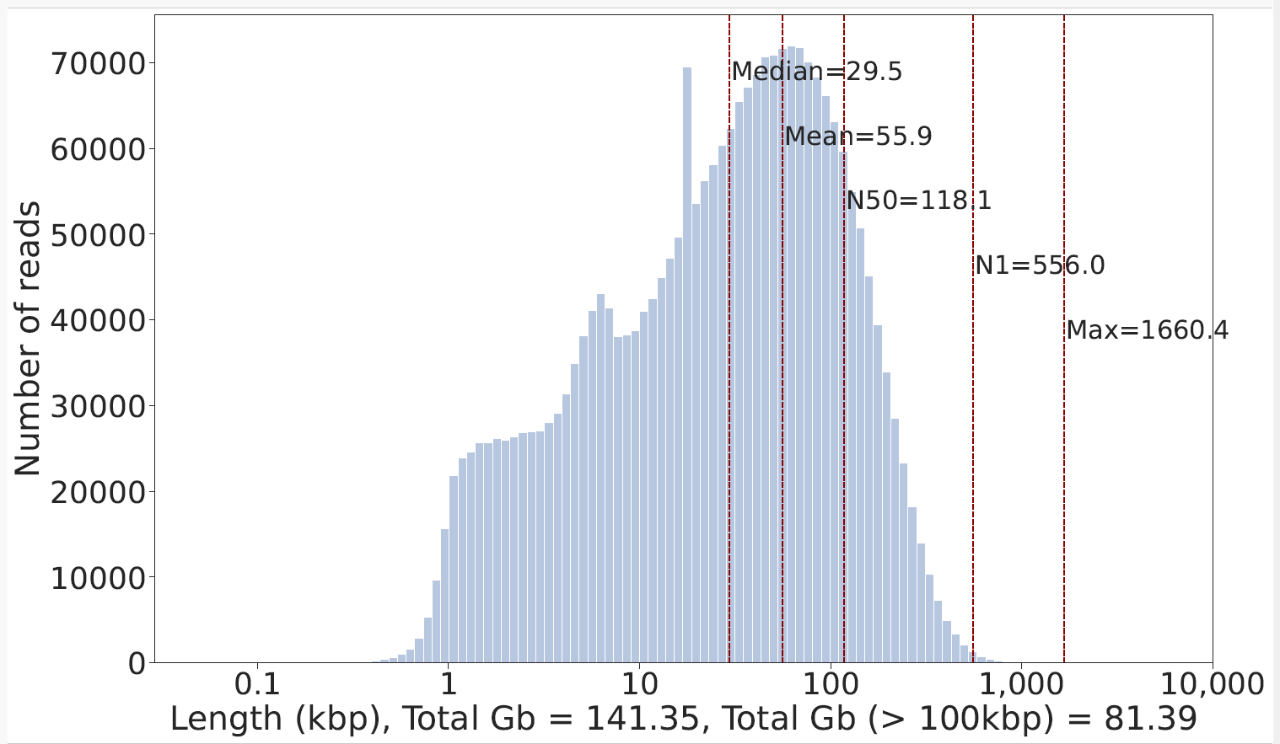
Sample ID | Common name | # of flow cells run | Total ONT data generated (Gbp; fold cov) | Read N50 (kbp) | UL ONT data generated (Gbp; fold cov) | UL ONT/ ONT (%)
PR00740 | Diademed Sifaka | 1(PC1) | 52.77; 17.02x | 131.6 | 32.28; 10.41x | 61.17
 |  | 2(FN1,2) | 141.35; 45.59x | 118.1 | 81.39; 26.25x | 57.58
 |  | Total 3 | 194.12; 62.62x | 121.3 | 113.67; 36.66x | 58.55
OK
PR00740-PC1
PR00740-All
PR00740-2FN

Slide 13
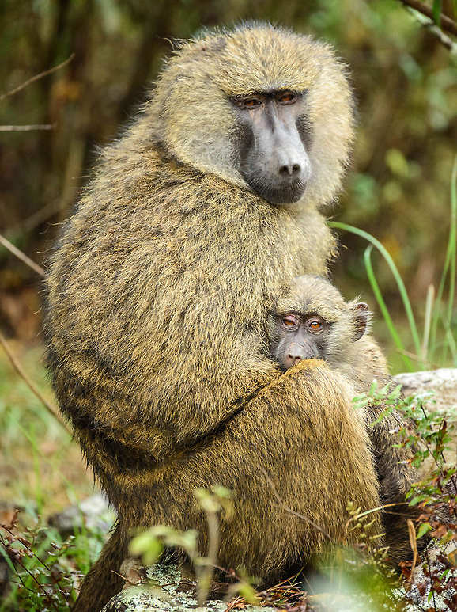
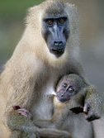
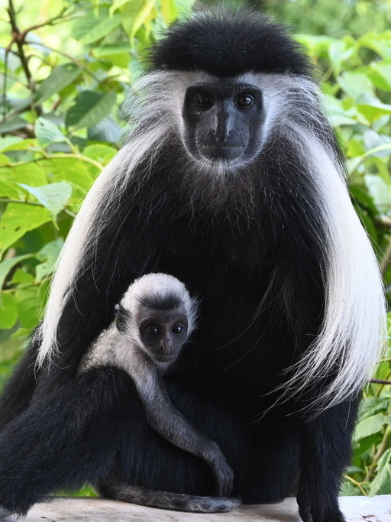
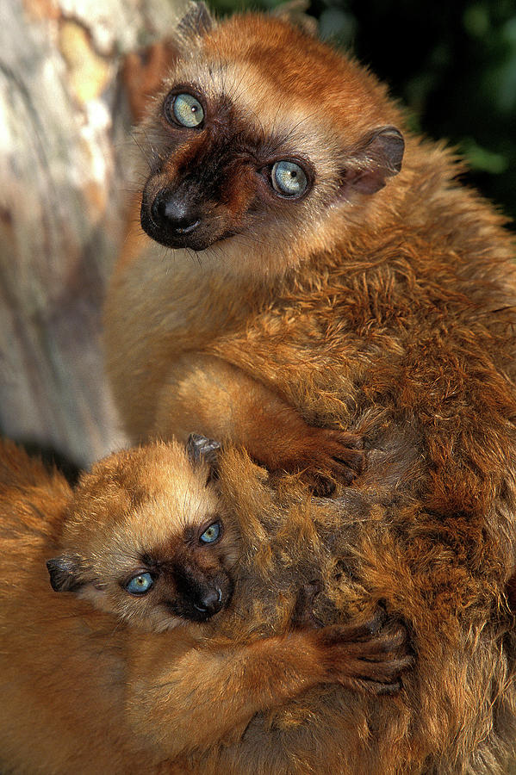
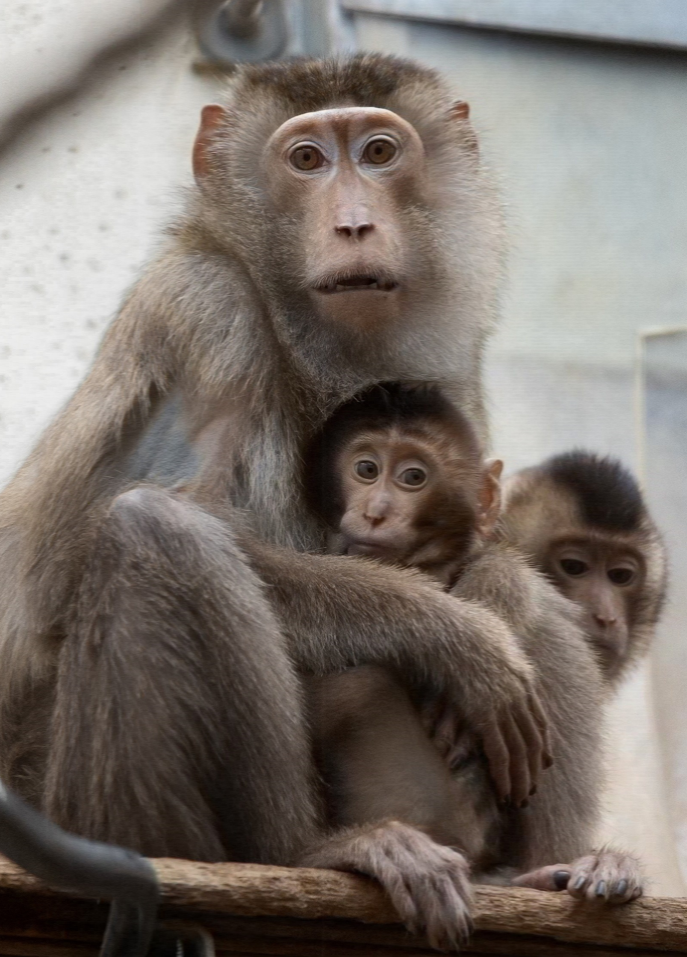
Summary of sample #1-5
PAN
MLE
CAN
EMA
MNE
Sample ID | Common name | # of flow cells run | Total ONT data generated (Gbp; fold cov) | Read N50 (kbp) | UL ONT data generated (Gbp; fold cov) | UL ONT/ ONT (%) | Future work
PR00036 | Olive Baboon | 2FN, 2PC | 202.44; 65.30x | 78.3 | 77.49; 25.00x | 38.27 | OK
PR00232 | Drill | 3FN, 1PC | 202.01; 65.16x | 87.6 | 88.07; 28.41x | 43.60 | Ok
PR00099 | Angolan Colobus | 1FN, 1PC | 166.45; 53.69x | 97.5 | 81.42; 26.26x | 48.91 | OK
PR00128 | Black Lemur | 1FN, 2PC | 171.59; 55.35x | 93.8 | 81.29; 26.22x | 47.37 | OK
PR00030 | Southern Pig-tailed Macaque | 2FN, 2PC | 183.67; 59.24x | 98.7 | 90.7; 29.26x | 49.38 | OK

Slide 14
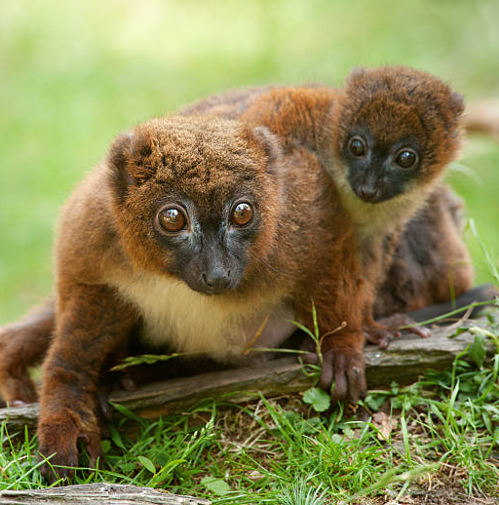
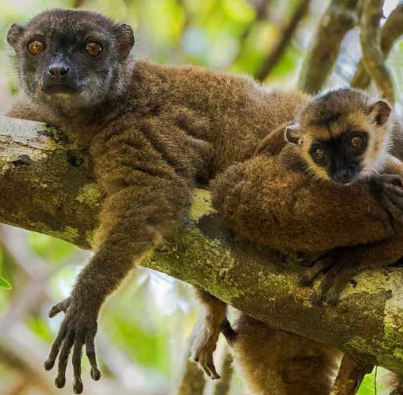
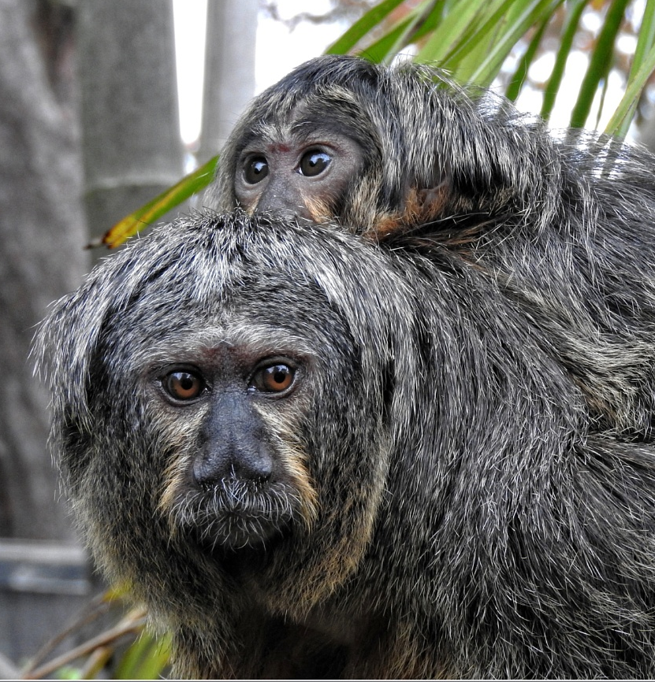
Summary of sample #6-10
ERU
EFU
LLA
LRO
PPI
Sample ID | Common name | # of flow cells run | Total ONT data generated (Gbp; fold cov) | Read N50 (kbp) | UL ONT data generated (Gbp; fold cov) | UL ONT/ ONT (%) | Future work
PR00129 | Red-bellied Lemur | 3 (2PC, 1FN) | 162.69; 52.48x | 99.0 | 80.75; 26.05x | 49.63 | OK
PR00246 | Brown Lemur | 4 (2PC, 2FN) | 200.16; 64.57x | 90.2 | 91.69; 29.58x | 45.81 | OK
PR00525 | Common Woolly Monkey | 3 (2PC, 1FN) | 199.17; 64.25x | 103.5 | 102.44; 33.05x | 51.43 | OK
PR00786 | Golden Lion Tamarin | 4 (2PC, 2FN) | 198.89; 64.15x | 97.1 | 97.17; 31.34x | 48.85 | ok
PR00239 | White-faced Saki | 3 (2PC, 1FN) | 201.93; 65.14x | 106.1 | 105.88; 34.15x | 52.43 | OK

Slide 15
Sequenced sample # 14-17 (38 million cells/sample)
HLA
MNI
PDI
MSI
Sample ID | Common name | # of flow cells run | Total ONT data generated (Gbp; fold cov) | Read N50 (kbp) | UL ONT data generated (Gbp; fold cov) | UL ONT/ ONT (%) | Future work
PPG00715 | Lar Gibbon | 3 (1PC, 2FN) | 129.55; 41.79x | 108.5 | 69.09; 22.28x | 53.33 | ok
PPG00726 | Celebes Crested Macaque | 3 (1PC, 2FN) | 142.36; 45.92x | 104 | 73.24; 23.62x | 51.45 | ok
PPG00740 | Diademed Sifaka | 3 (1PC, 2FN) | 194.12; 62.62x | 121.3 | 113.67; 36.66x | 58.55 | Ok
PPG00833 | Lion-tailed Macaque | 3 (1PC, 2FN) | 175.94; 56.75 | 109.3 | 94.17; 30.37x | 53.52 | ok
Notes:
Monkeys are divided into two main groups, Old World and New World, based on their geographic location and several other characteristics:
Location
Old World monkeys live in Africa, Asia, and Europe, while New World monkeys live in Central and South America.
Nose
Old World monkeys have narrow noses with nostrils that face downward, while New World monkeys have broad noses with nostrils that face outward. The term "platyrrhine" means "flat-nosed" in Latin, and refers to the New World monkeys.
Tails
Some New World monkeys, like spider monkeys, have prehensile tails, but Old World monkeys do not.
Rump pads
Some Old World monkeys have hard, bare sitting pads on their buttocks, but New World monkeys do not.
Cheek pouches
Some Old World monkeys, like macaques, have cheek pouches for storing food.
Intelligence
Old World monkeys are generally considered more intelligent than New World monkeys.
Thumbs
Old World monkeys have more opposable thumbs than New World monkeys.
Habitat
Old World monkeys spend most of their time on the ground, while New World monkeys spend most of their time in trees.

Slide 16
Sequenced sample # 19-20 (38 million cells/sample)
HAG
MFU
GSE
Sample ID | Common name | # of flow cells run | Total ONT data generated (Gbp; fold cov) | Read N50 (kbp) | UL ONT data generated (Gbp; fold cov) | UL ONT/ ONT (%) | Future work
PPG00773 | Agile Gibbon | 3 (1PC, 2FN) | 157.98; 50.96x | 131 | 96.97; 31.28x | 61.38 | ok
PPG00782 | Japanese Macaque | 3 (1PC, 2FN) | 107.17; 34.57x | 98.3 | 52.98; 17.09x | 49.43 | Ok (Total 26.2x)
 |  | 1FN |  | 128.6 | 53.4; 9.1x
PPG01034 | Northern Lesser Galago | 3 (1PC, 2FN) | 123.54; 39.85x | 123.8 | 72.71; 23.45x | 58.85 | Ok (Total 29.8x)
 |  | 1FN |  | 121.45 | 39.33; 6.3x
Notes:
Monkeys are divided into two main groups, Old World and New World, based on their geographic location and several other characteristics:
Location
Old World monkeys live in Africa, Asia, and Europe, while New World monkeys live in Central and South America.
Nose
Old World monkeys have narrow noses with nostrils that face downward, while New World monkeys have broad noses with nostrils that face outward. The term "platyrrhine" means "flat-nosed" in Latin, and refers to the New World monkeys.
Tails
Some New World monkeys, like spider monkeys, have prehensile tails, but Old World monkeys do not.
Rump pads
Some Old World monkeys have hard, bare sitting pads on their buttocks, but New World monkeys do not.
Cheek pouches
Some Old World monkeys, like macaques, have cheek pouches for storing food.
Intelligence
Old World monkeys are generally considered more intelligent than New World monkeys.
Thumbs
Old World monkeys have more opposable thumbs than New World monkeys.
Habitat
Old World monkeys spend most of their time on the ground, while New World monkeys spend most of their time in trees.

Slide 17
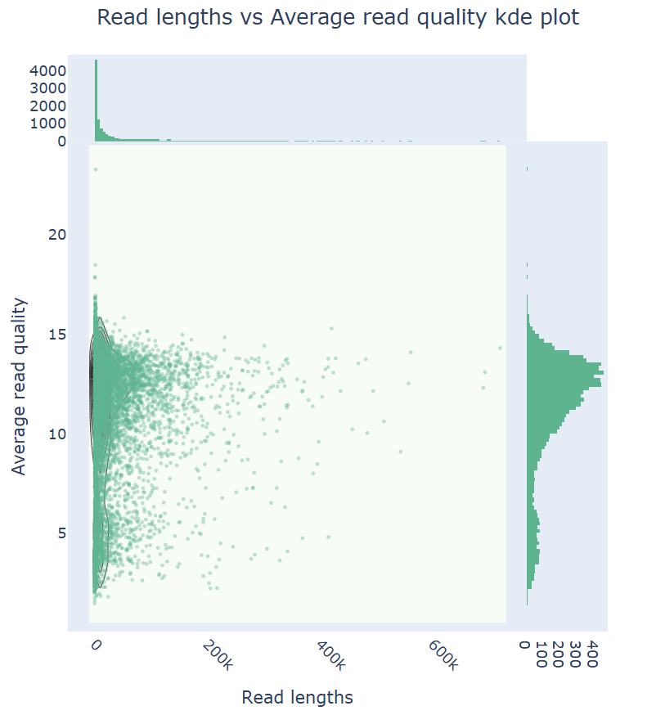
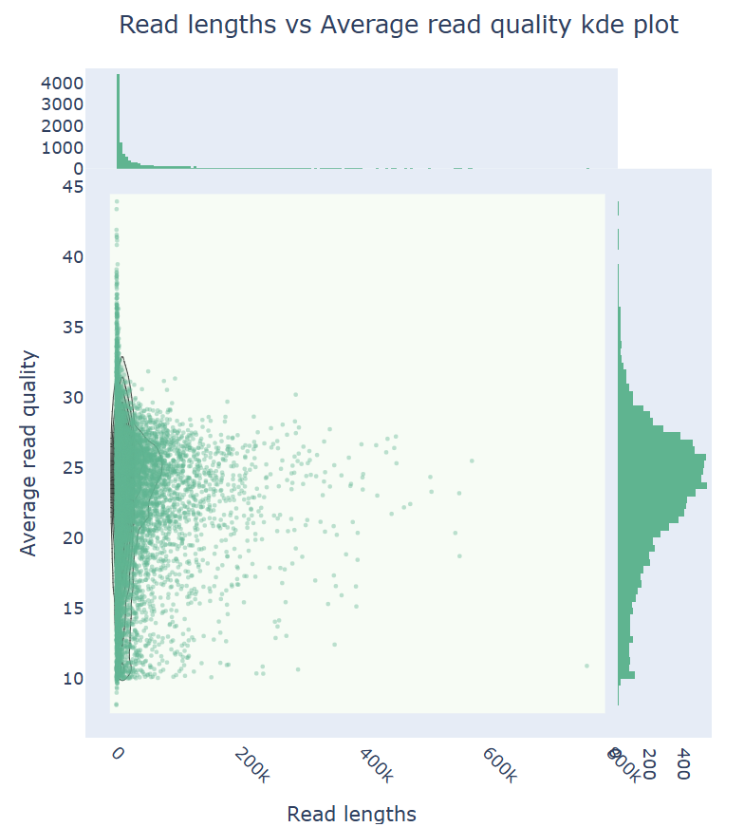
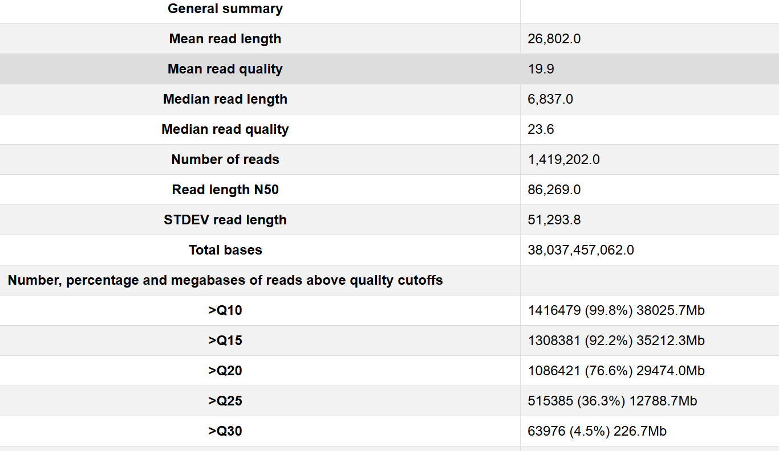
NanoPlot-20250128_ nhp_MFU_PR00782_ULK114 >>>New flow cell
Fast model
Super accurate model
(Generated by Keith)

Slide 18
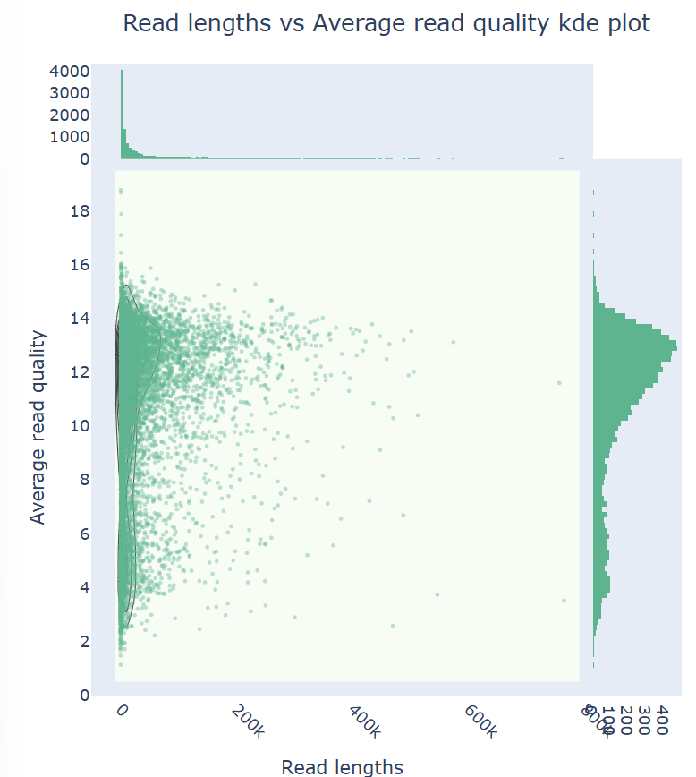
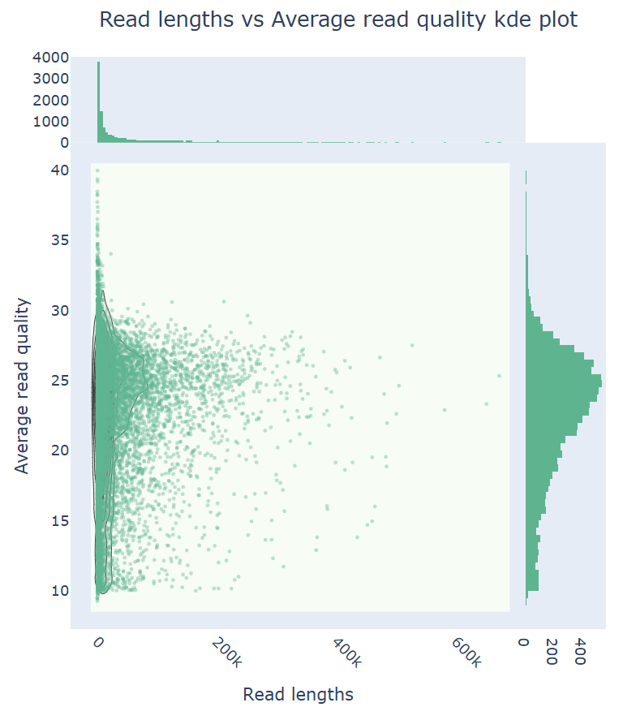
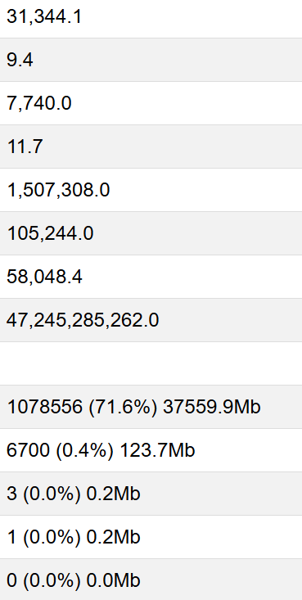
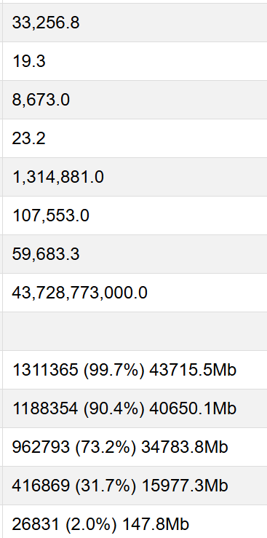
NanoPlot-20250128_ nhp_GSE_PR01034_ULK114 >>>Old flow cell
(Generated by Keith)

Slide 19
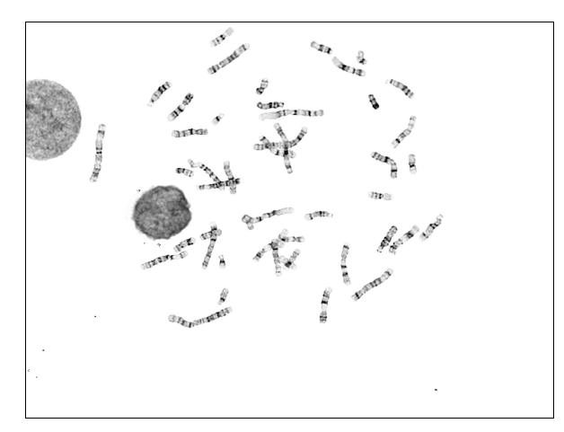
LT18 project (UT Health)
 | LT18-7C | LT18-7M | LT18-7P | LT18-34C | LT18-34M | LT18-34P
Karyotyping | V | V | V | V | V | V
ONT sequencing | O | O | O | O | O | X
PacBio sequencing | O | O | O | O | O | X
Kinnex Iso-Seq | O | O | O | O | O | X
Omni-C | O | O | O | O | O | X
Back-up cells | O | O | O | O | O | O
V: Done. Received results on 3/6/2025
O: Pending
X: Not enough cells

Slide 20
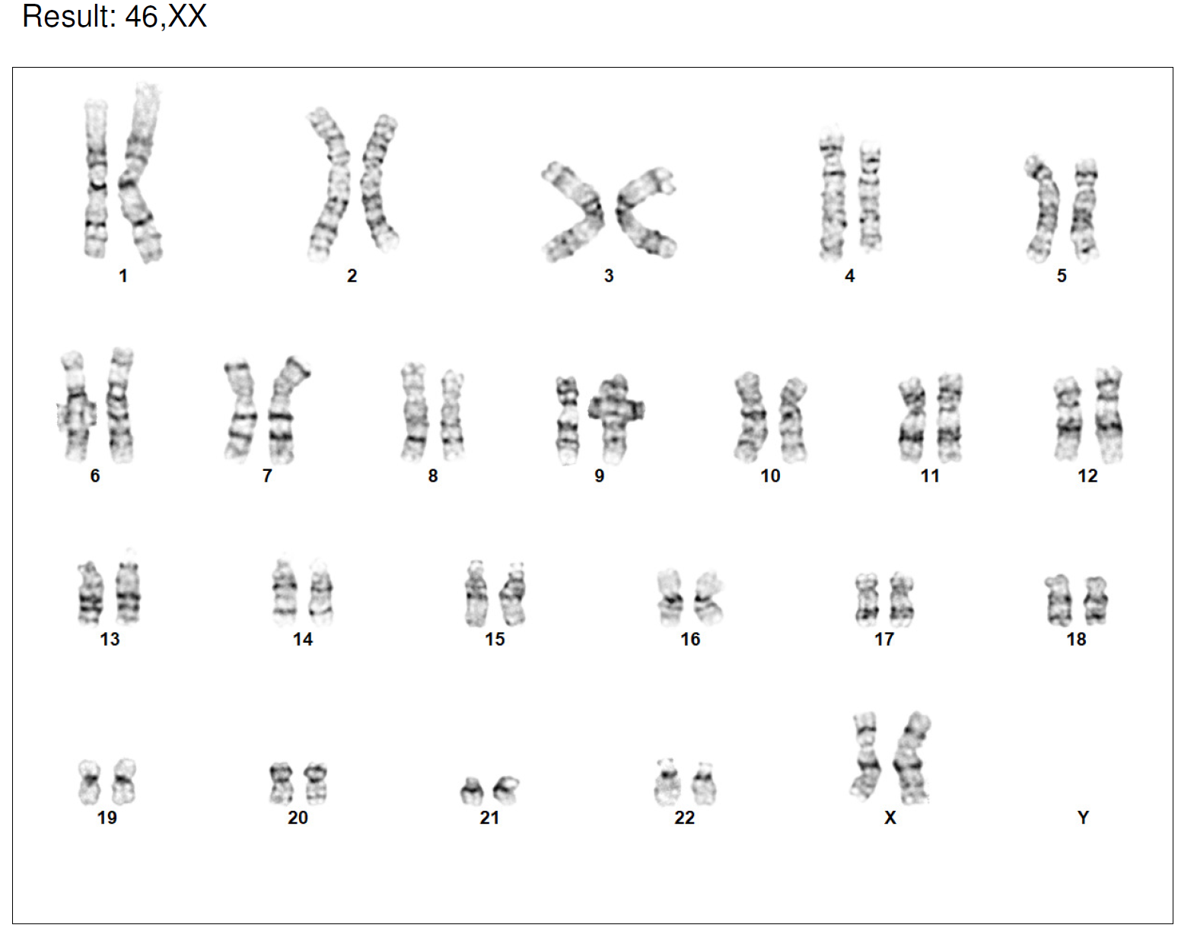
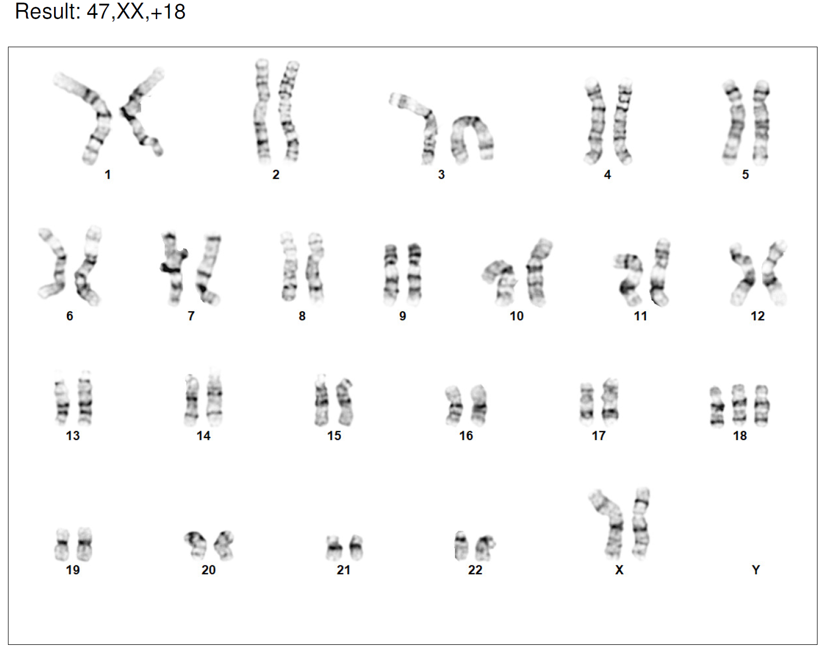
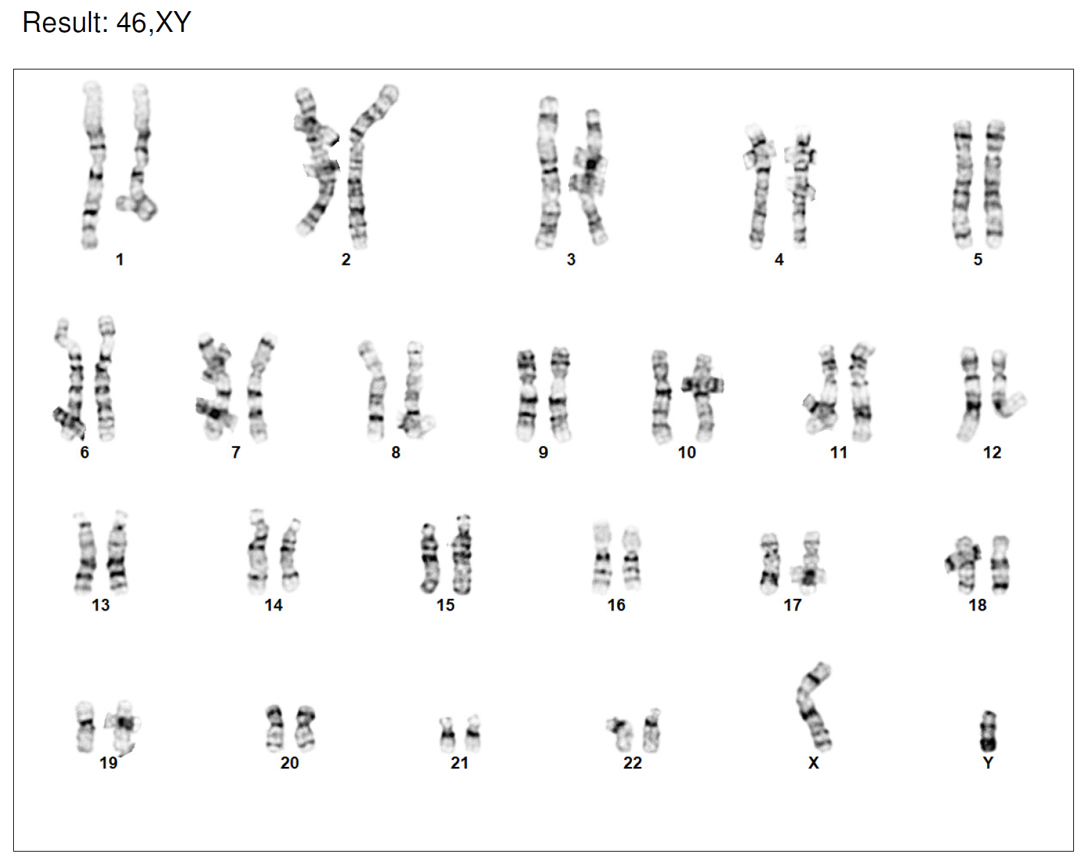
Karyotyping results: LT18-7 family
LT18-7M: 46, XX (20/20 cells are normal.)
LT18-7C: 47, XX, +18 (20/20 cells have Trisomy 18.)
LT18-7P: 46, XY (20/20 cells are normal.)

Slide 21
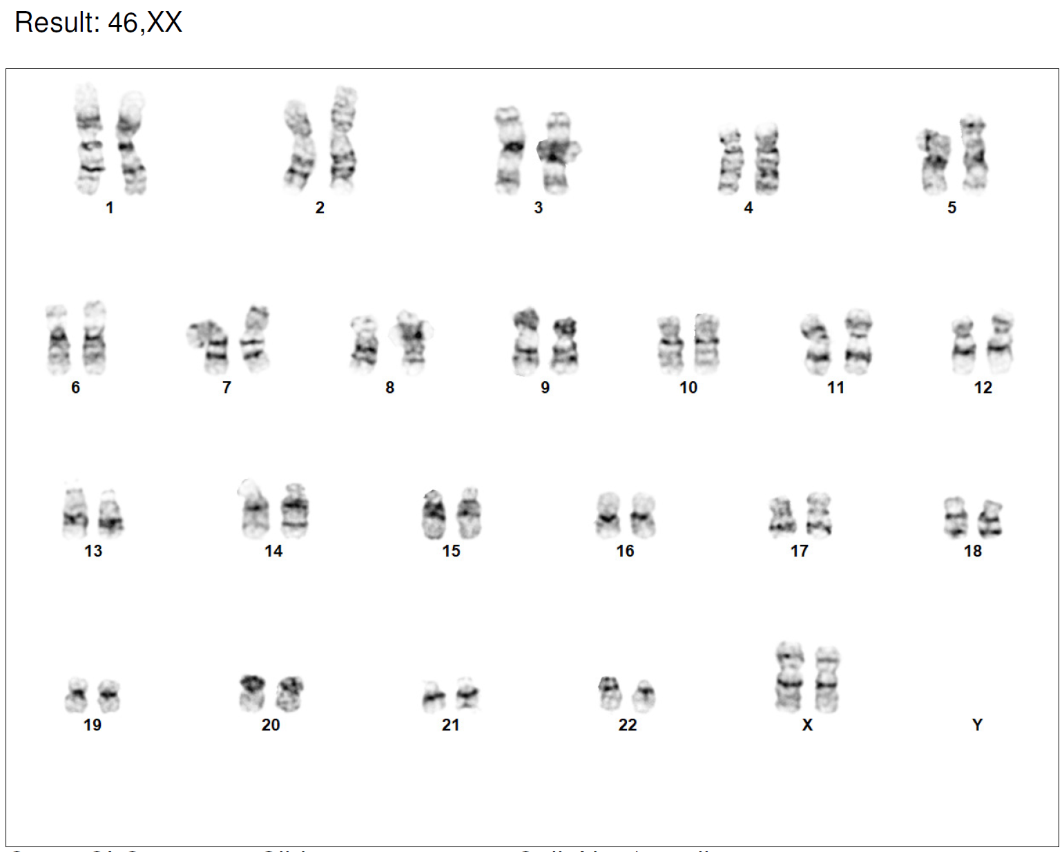
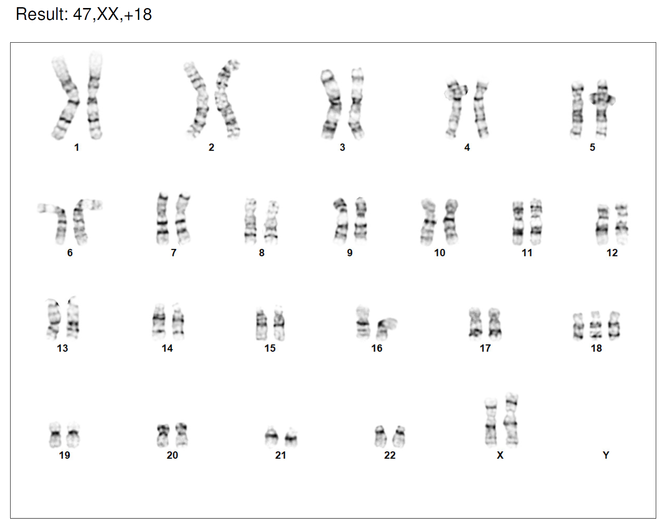
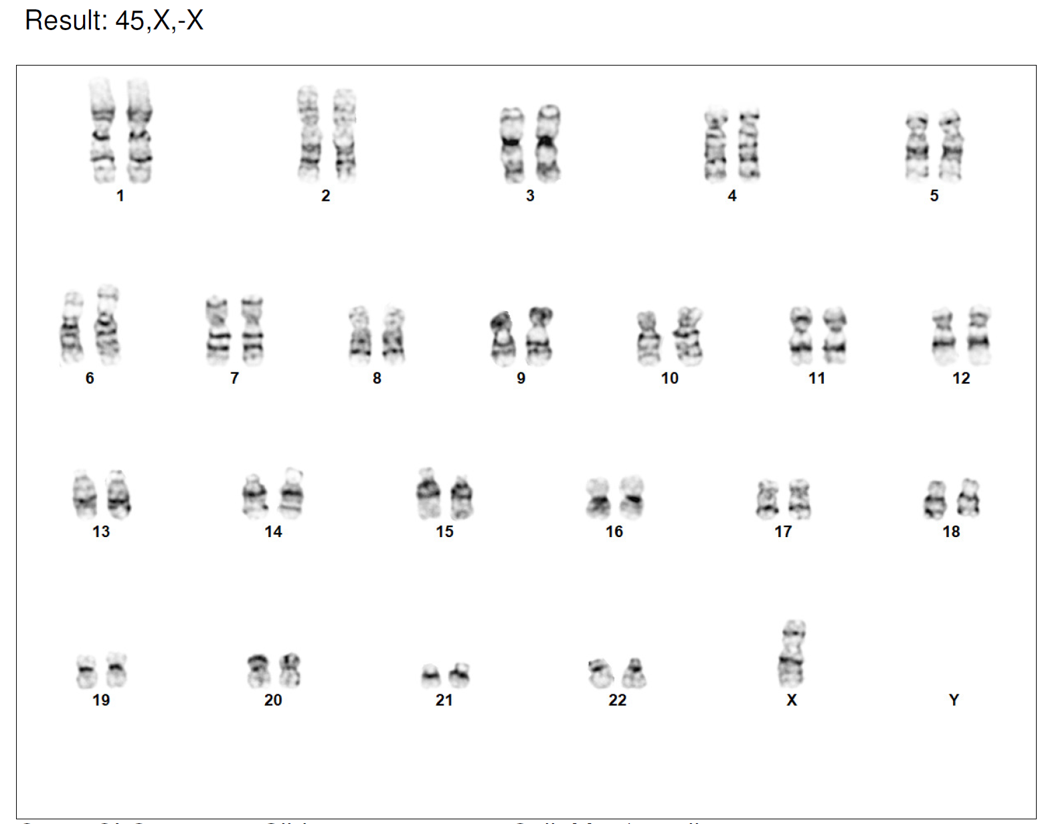
Karyotyping results: LT18-34 family
LT18-34M:
46, XX
(8/20 cells are normal.)
II. 45, X, -X
(12/20 cells have only 1 X.)
LT18-34C: 47, XX, +18 (20/20 cells have Trisomy 18.)

Slide 22
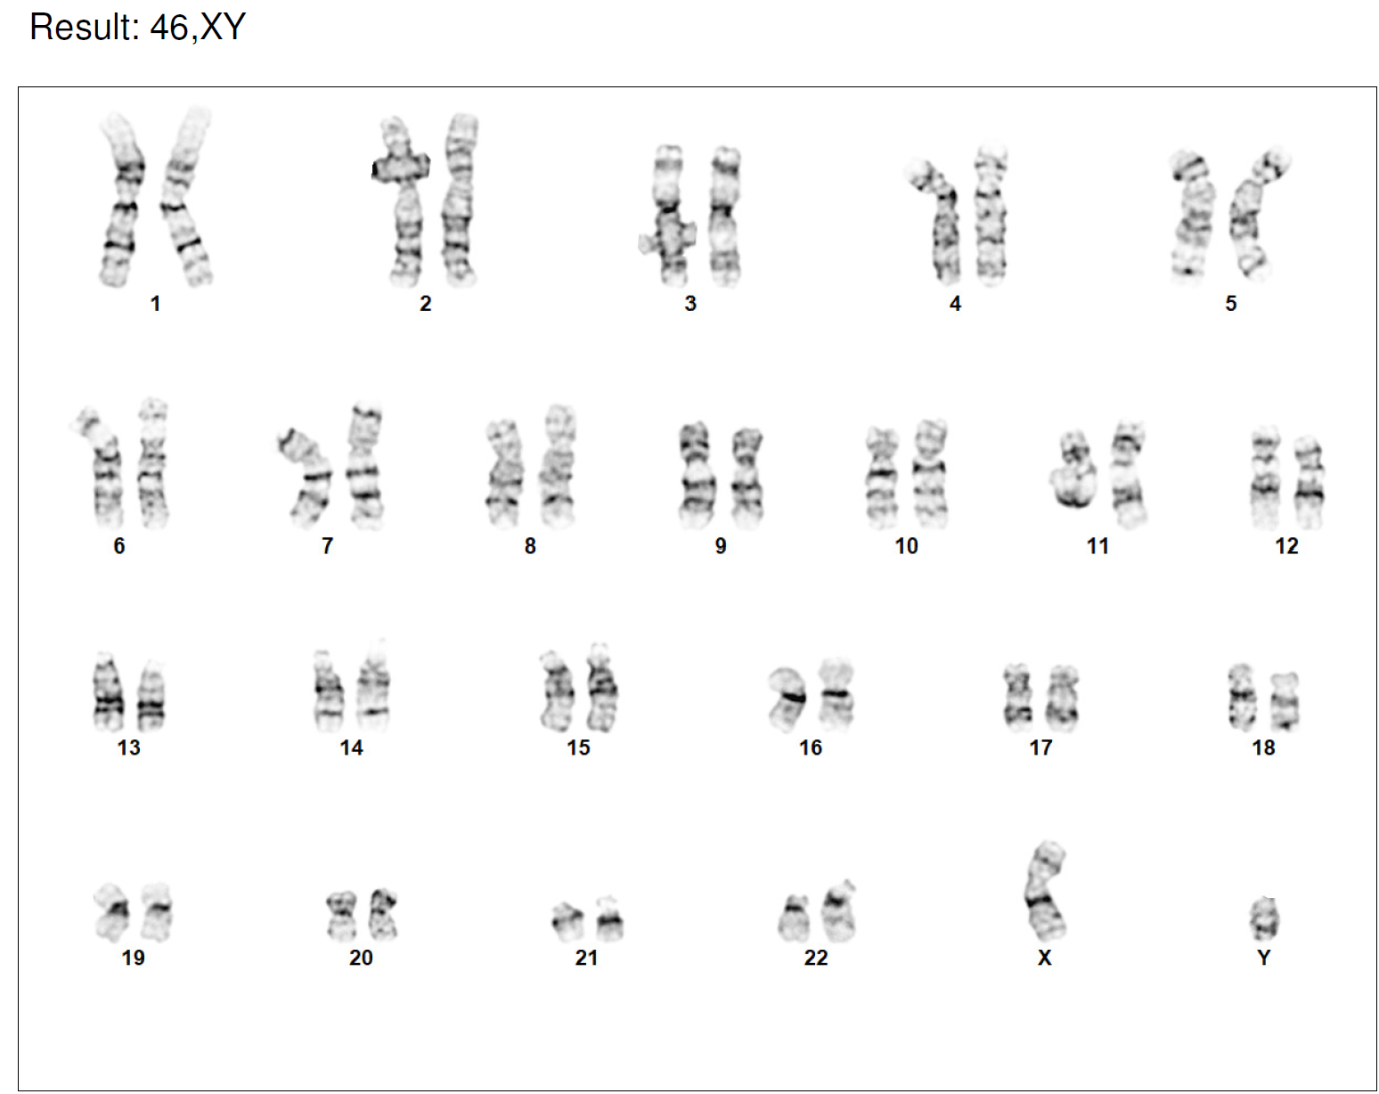
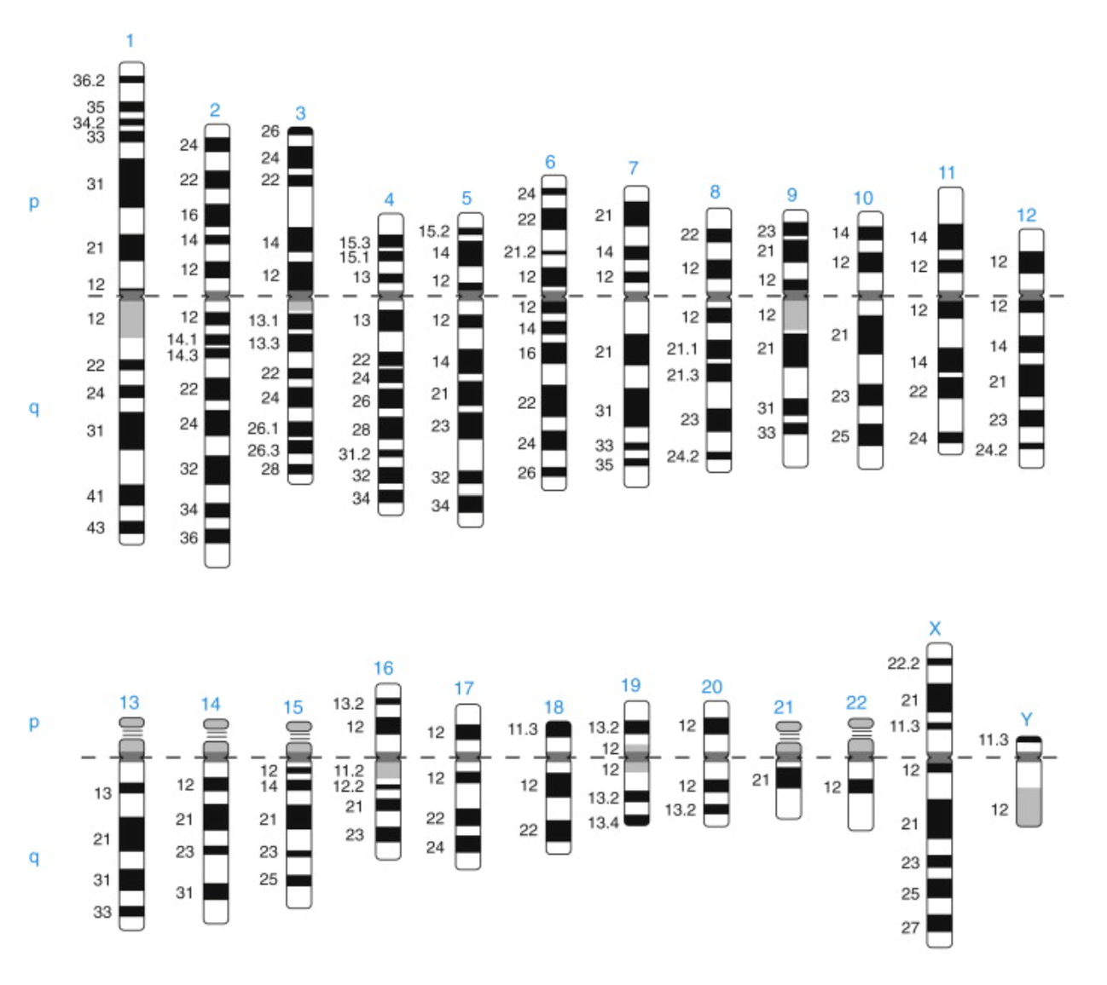
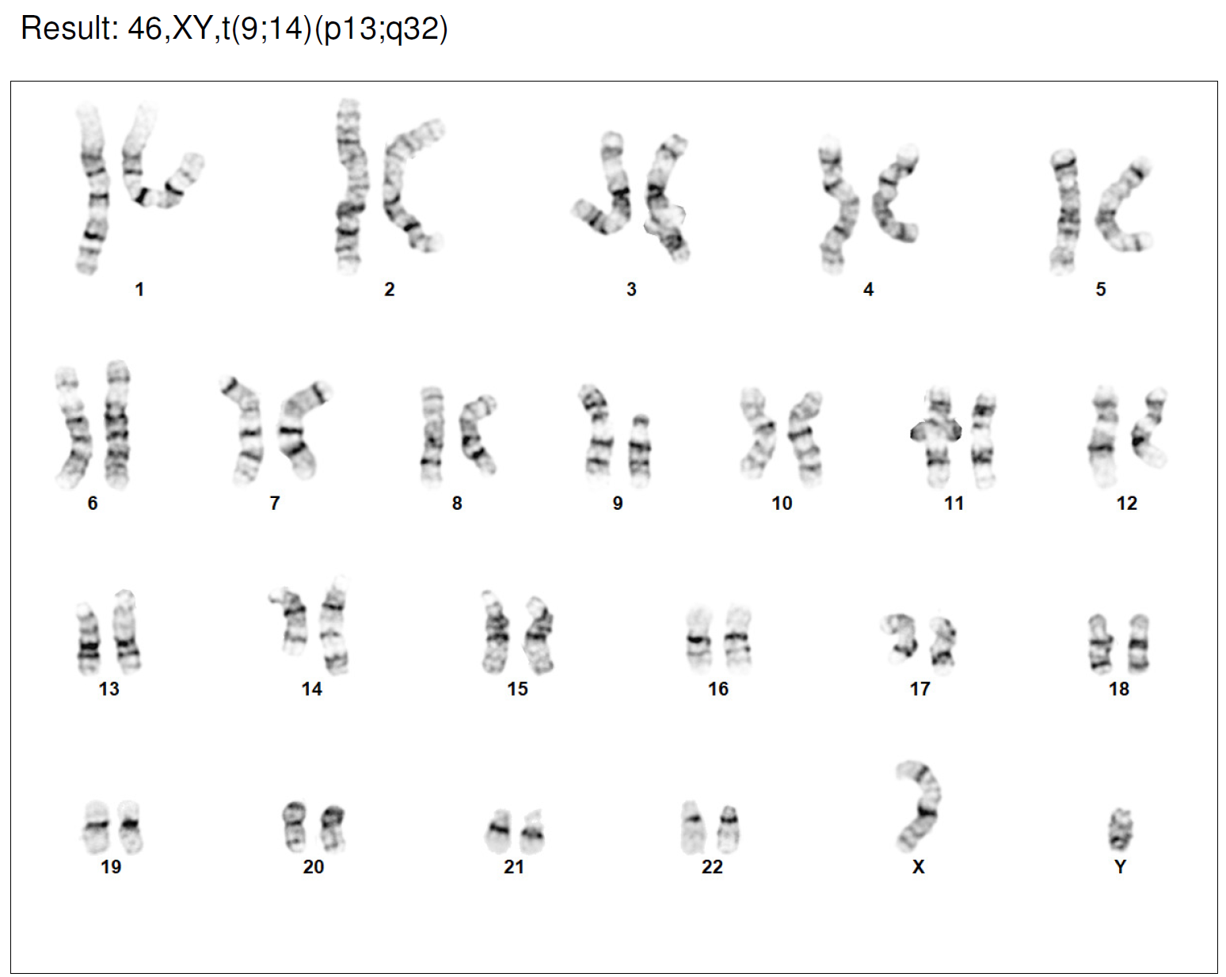
Karyotyping results: LT18-34 family
LT18-34P:
I. 46, XY (17/20 cells have a normal karyotype)
II. 46, XY, t (9;14)(p13;q32)
(3/20 cells have a reciprocal translocation between 9p13 and 14q32.)
(https://www.sciencedirect.com/topics/medicine-and-dentistry/chromosome-identification)
Notes:
The most routinely used technique stains the metaphase chromosomes with Giemsa (after using the enzyme trypsin to digest proteins). Each chromosome pair stains with its own characteristic banding pattern. The bands (G bands) correlate approximately with the DNA sequence underlying it: AT-rich areas stain darkly, GC-rich areas lightly. An idealized picture of such a G-banded karyotype (called an ideogram) is shown in Figure 11.2. About 400 dark bands per haploid genome are seen in this way.

Slide 23
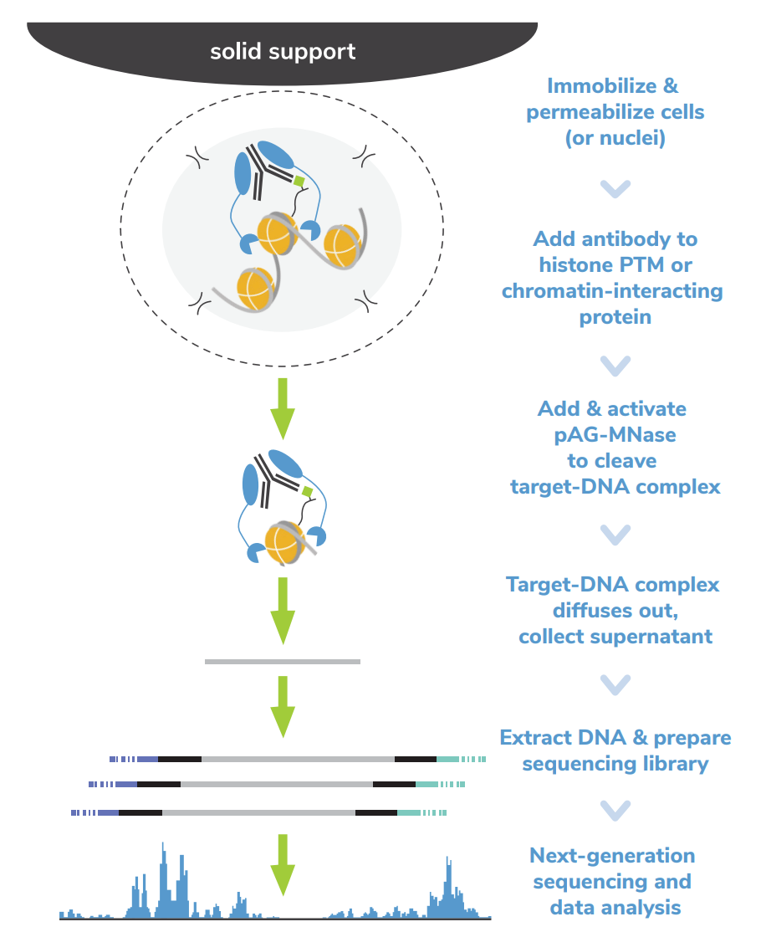
CUTANA-CUT&RUN
Cleavage Under Targets & Release Using Nuclease
Histone post-translational modifications (PTMs): H3K4me3 (positive control)
Chromatin-associated proteins: CenP-A

Slide 24
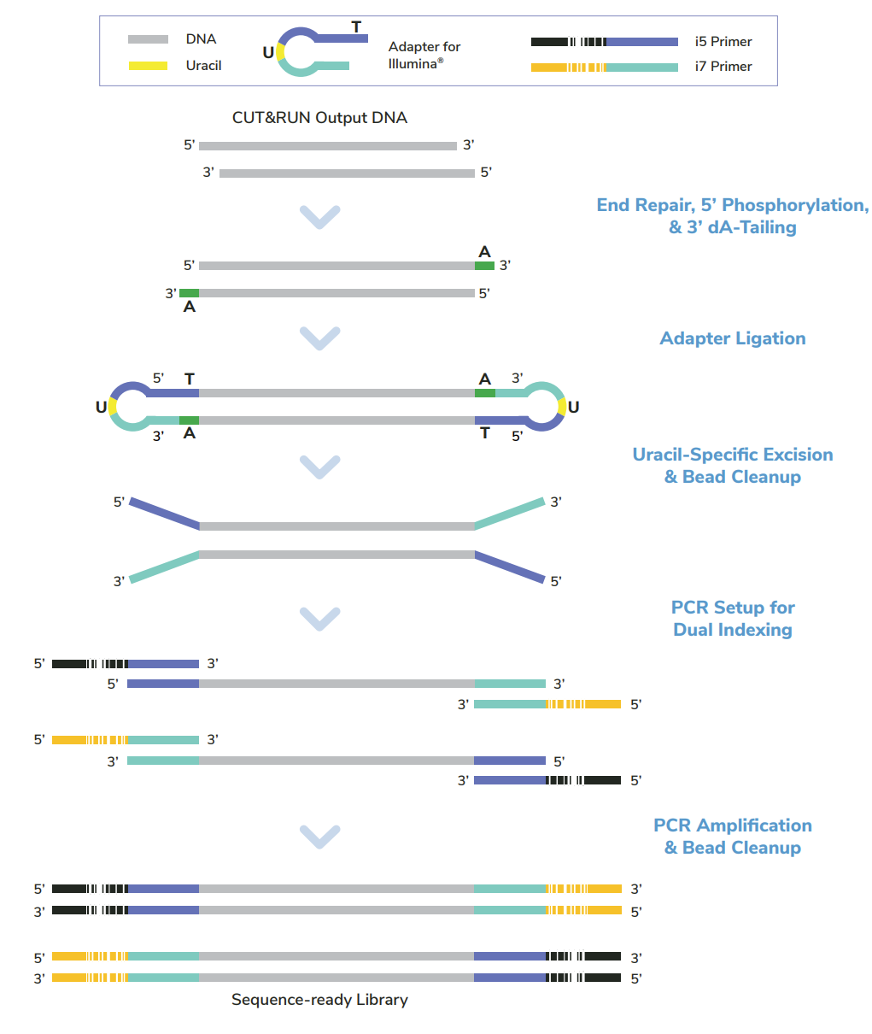
CUT & RUN DNA
ID (Nuclei from 0.55e6 cells) | Antibody | pAG-Mnase | Binding temp, time | CaCl2 digestion temp, time | ng/ul | ng in total 15ul
1 | CENP-A | 2.5ul | RT, 10 min | 4C, 2hr | 0.84 | 12.6
2 | H3K4Me3 | 2.5ul | RT, 10 min | 4C, 2hr | 1.24 | 18.6
3 | CENP-A | 2.5ul | 4C, 1hr | 4C, 1hr | 0.96 | 14.4
4 | H3K4Me3 | 2.5ul | 4C, 1hr | 4C, 1hr | 1.01 | 15.15
CUT & RUN Library Prep to amplify CUT&RUN DNA (5ng)
Amplified DNA for ONT-NBD114 kit (400ng/ sample)

Slide 25
Polymerase test
Hot Start 2X PCR Master Mix
PCR: 98°C, 45sec → 14X [98°C, 15sec; 60°C, 50sec] → 72°C, 1min
KOD Xtreme Hot Start DNA Polymerase
Input DNA: 50ng
PCR: 94°C, 2min → 17X [98°C, 10sec; 55°C, 30sec; 68°C, 5min] → 68°C, 5min
Final volume: 25ul
Input DNA: 50ng
Final volume: 50ul

Slide 26
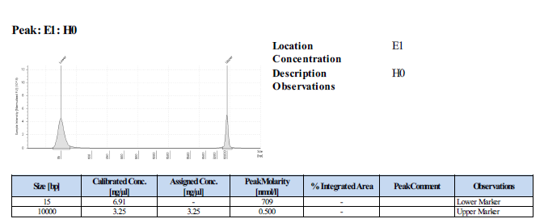
H3K4me3 results
ID | Polymerase amplification | Qubit (ng/ul) | TapeStation(ng/ul)
H0 | X (Original DNA) | 1.24 | NA
H1 | Hot start master mix * | 11.53 | 10.2
H2 | KOD Xtreme Hot Start** | 77.35 | 43
124
292
*:10ul **:14ul
129
292
(Protocol Figure 6)

Slide 27
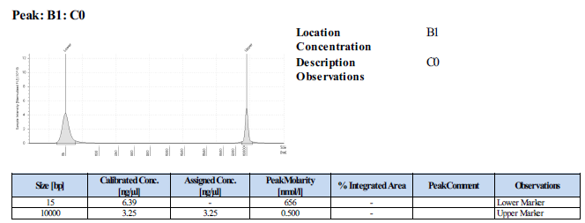
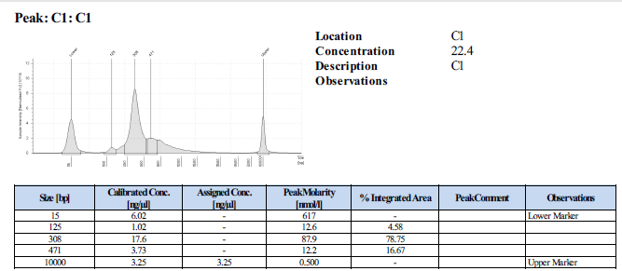
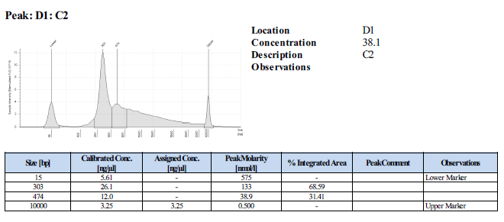
CenP-A results
ID | Polymerase amplification | Qubit (ng/ul)* | TapeStation(ng/ul)**
C0 | X (Original DNA) | 0.84 | NA
C1 | Hot start master mix* | 22.29 | 22.4
C2 | KOD Xtreme Hot Start** | 86.16 | 76.2
125
308
471
*:10ul **:14ul
303
474

Slide 28
Other projects
RIMGC samples from Carolina
PBMC isolation→ RIMGC002626 (P,S,M), RIMGC002639 (P,M,F)
ONT sequencing →2 FN are running for RIMGC002626P, RIMGC002626S
Fiber-seq → RIMGC002639P failed…
African genome from Sarron
Fiber-seq → D0111, D0552 (hold), D0783 (hold)
Omni-C → D0111, D0552, D0783
Kinnex-seq→ D0111, D0552, D0783 (hold)

